Slide 1

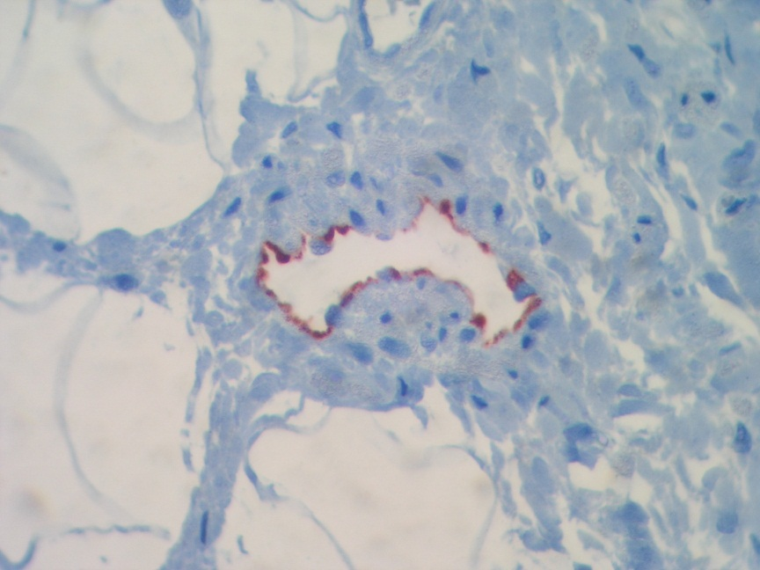
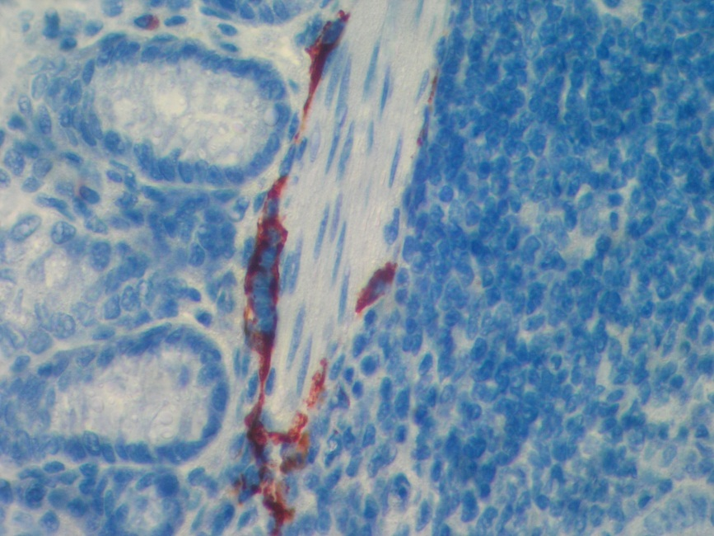
ReliaTech GmbH
Rabbit anti-human and mouse LYVE-1
(Cat #102-PA50S/-PA50; #103-PA50S/-PA50)
Human intestine (border area of a colon carcinoma
Mouse intestine
Immunohistochemistry with paraffin-embdded sections of human and mouse intestine with a polyclonal antibody directed against human LYVE-1 (Cat# 102-PA50) and mouse LYVE-1 (Cat# 103-PA50). You see the staining (red) of lymaphatic endothelial cells of the intestine.
The experiments has been performed by Dr. Karsten Debel, DCS, Hamburg, Germany.
http://www.reliatech.de / orders@reliatech.de

